Slide 1
Activity 5: IMAGE SEGMENTATION
Genesis Vertudez – 202003099
App Physics 157 - Computational Analysis and Modeling in Physics
Submitted to Dr. Maricor Soriano; Mx. Rene Principe Jr.

Slide 2
OBJECTIVES
Use ImageJ to manipulate images and extract their features
Apply threshold to grayscale histogram to separate objects from background

Slide 3
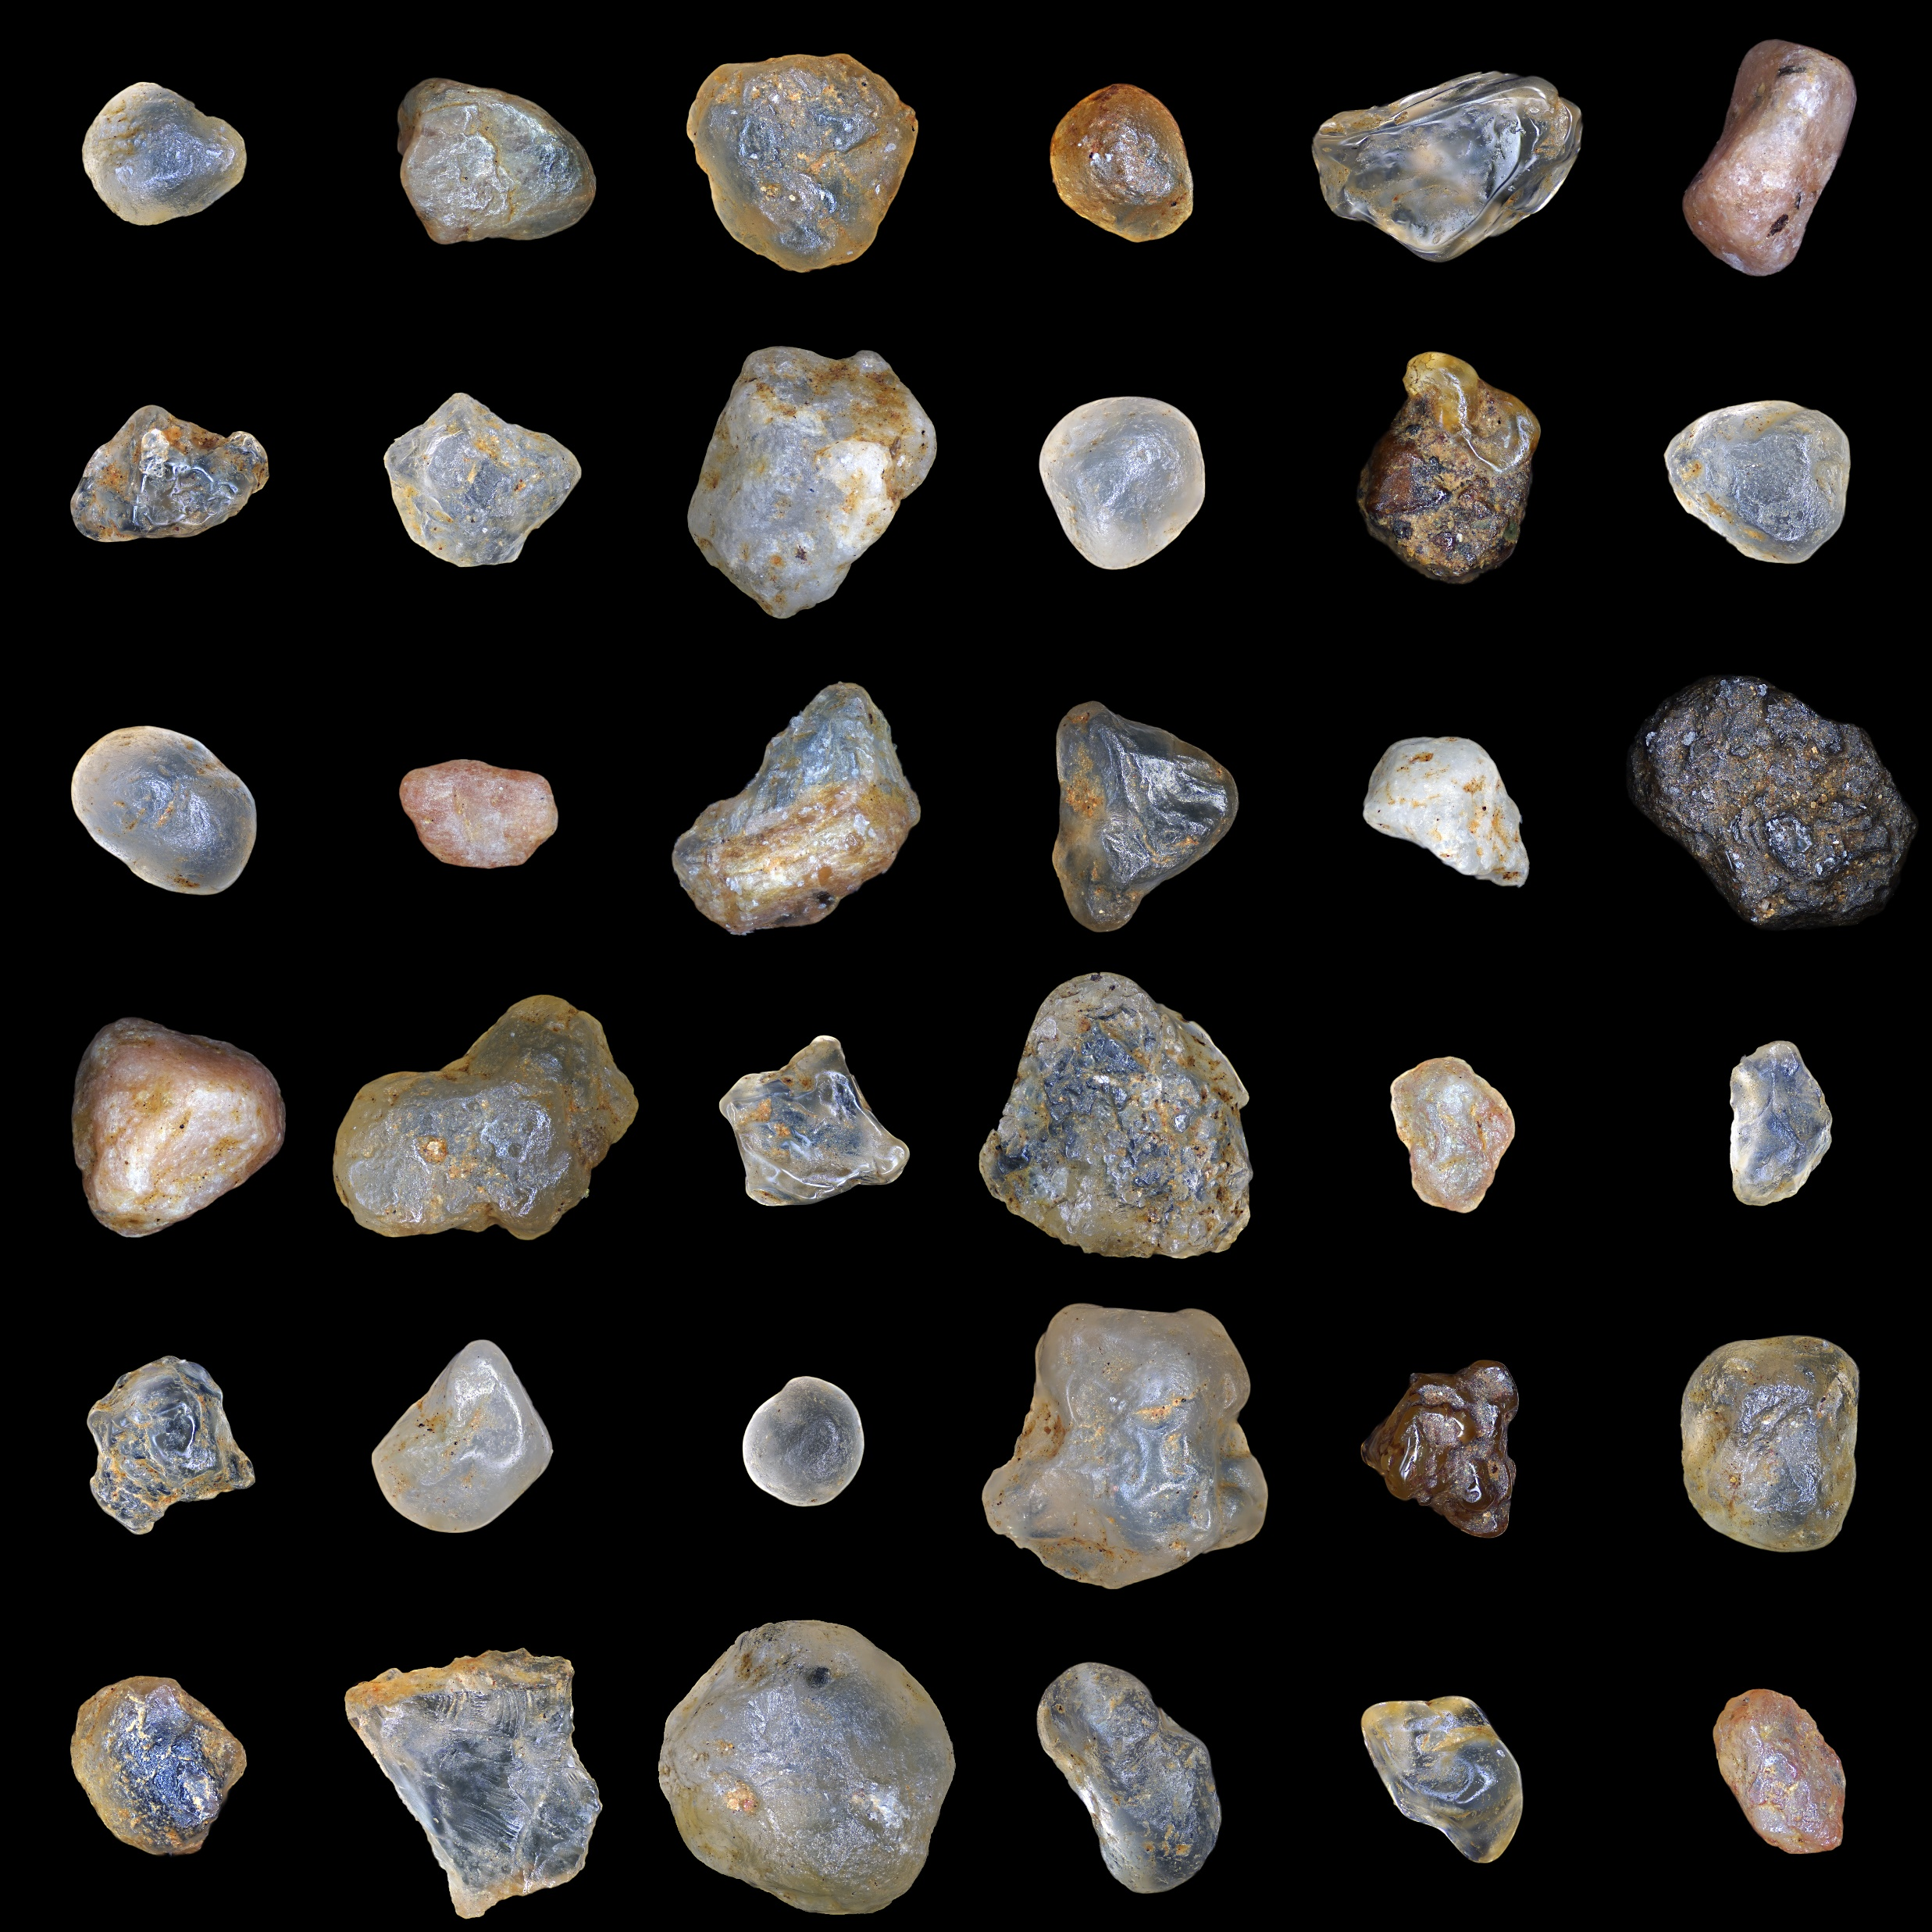
RESULTS & ANALYSIS
Image of sand particles
Codes and files: https://github.com/genvert/AP_157_FX-2_Vertudez/tree/main/Activity%205

Slide 4
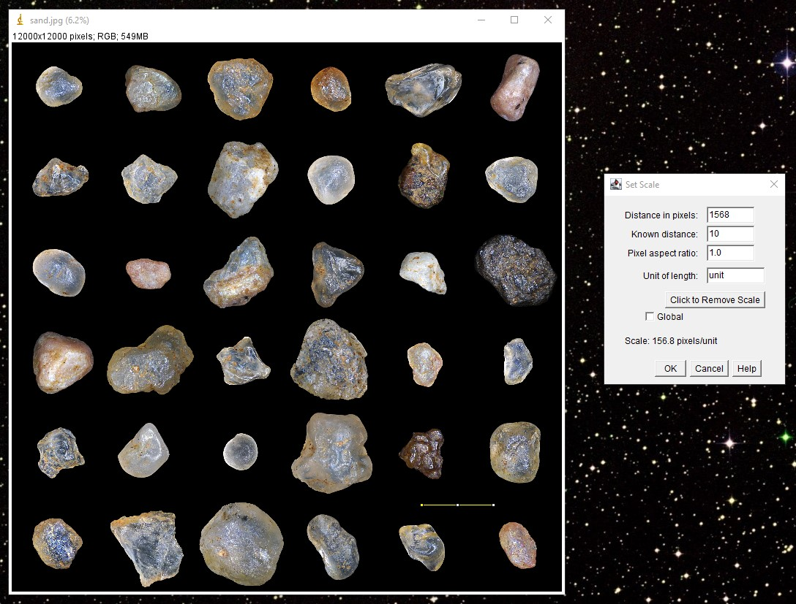
RESULTS & ANALYSIS
Setting scale
I just set an arbitrary scale as instructed. I used 10 units for about the same distance in the cell example.
Codes and files: https://github.com/genvert/AP_157_FX-2_Vertudez/tree/main/Activity%205

Slide 5
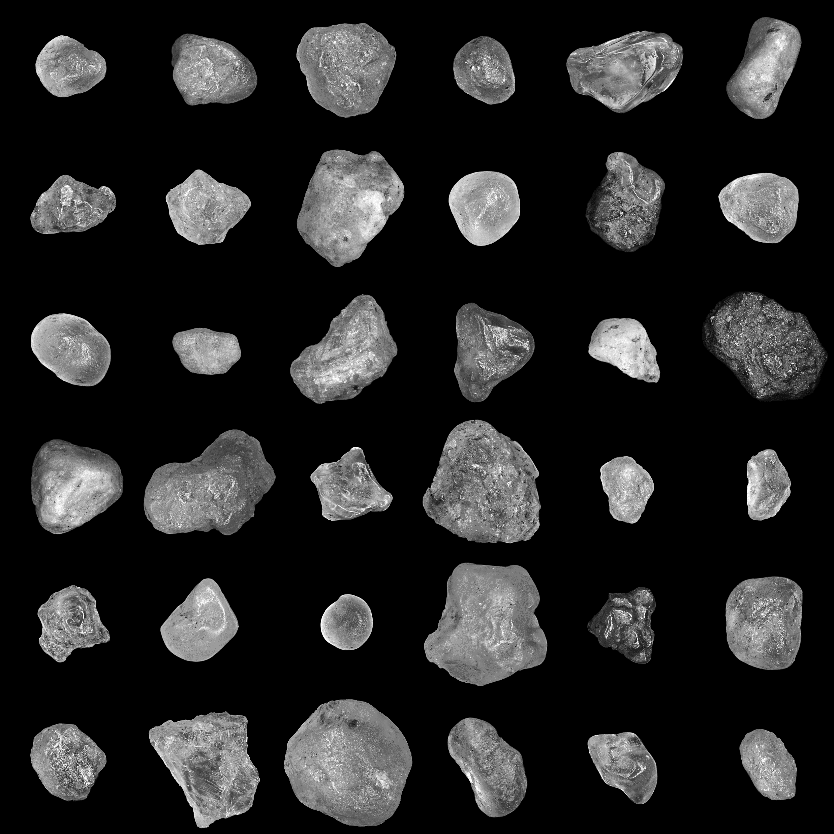
RESULTS & ANALYSIS
Converting to 8-bit
Applying threshold only works on grayscale images, so we convert it first.
Codes and files: https://github.com/genvert/AP_157_FX-2_Vertudez/tree/main/Activity%205

Slide 6
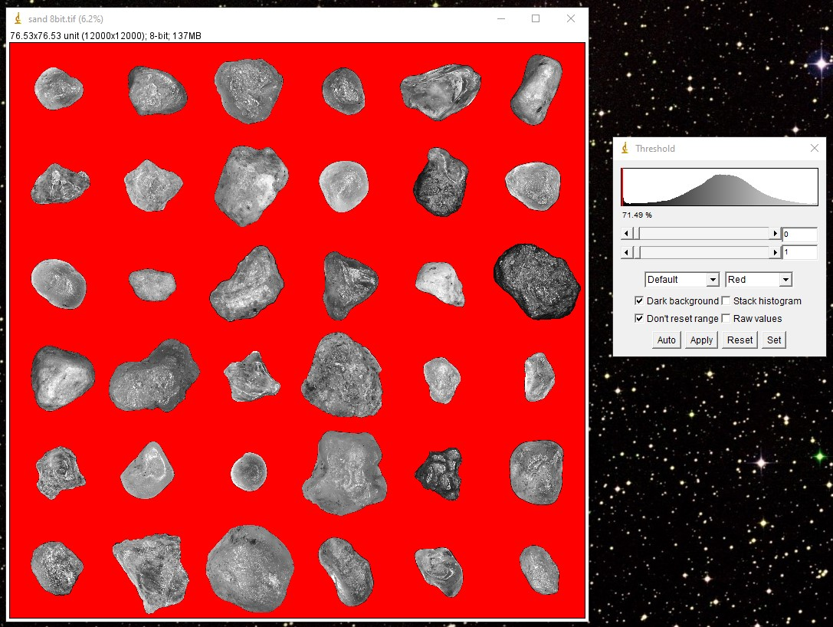
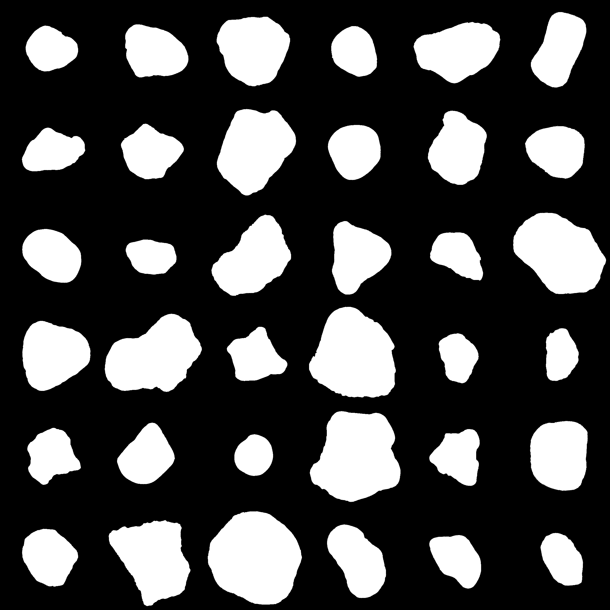
RESULTS & ANALYSIS
Applying threshold and binarizing
Since the background is black, it is easy to pick it out the histogram.
The image is then binarized to make sure that there are only two values for easier extraction of geometric features.
Codes and files: https://github.com/genvert/AP_157_FX-2_Vertudez/tree/main/Activity%205

Slide 7
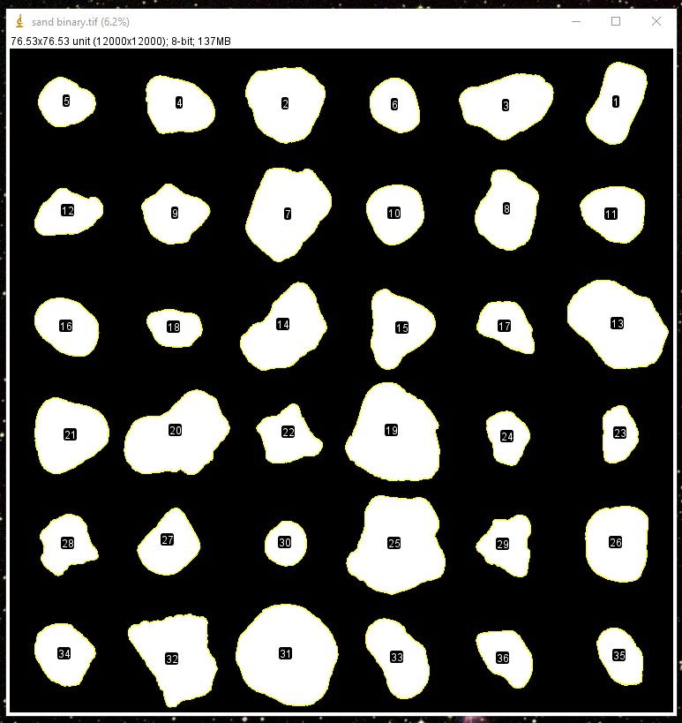
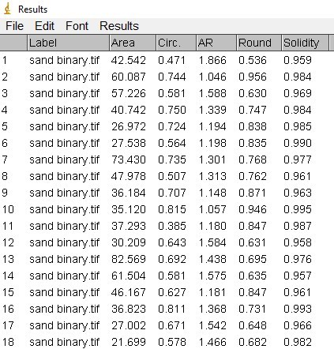
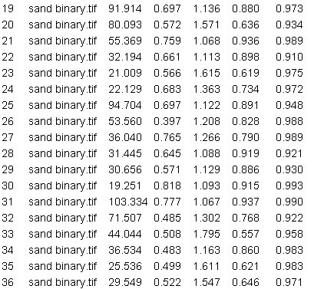
RESULTS & ANALYSIS
Analyze particles results
Codes and files: https://github.com/genvert/AP_157_FX-2_Vertudez/tree/main/Activity%205

Slide 8
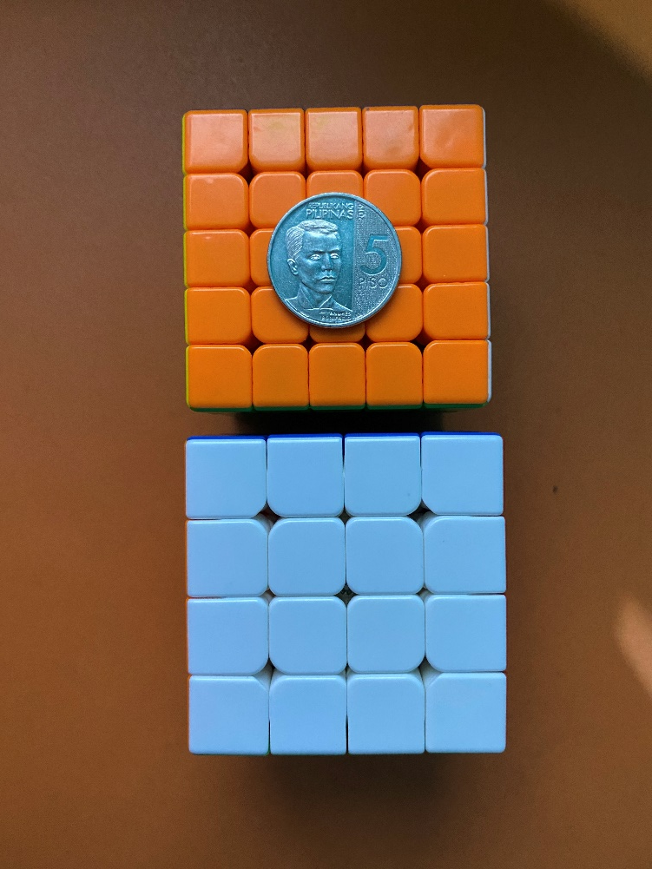
RESULTS & ANALYSIS
Image of a 4x4x4 Rubik’s cube
Codes and files: https://github.com/genvert/AP_157_FX-2_Vertudez/tree/main/Activity%205

Slide 9
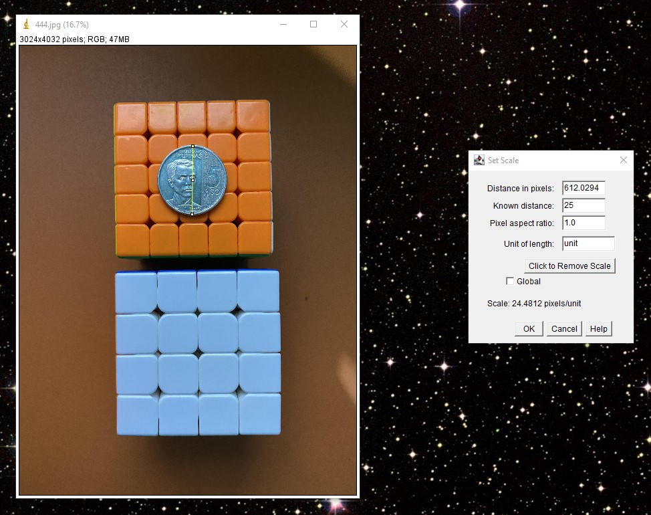
RESULTS & ANALYSIS
Setting scale
I used a 5 peso coin on top of a 5x5x5 cube which is about the same height as a 4x4x4 (if I just put it on the table, the height difference affects the scaling) for scaling. It is about 25 mm.
Codes and files: https://github.com/genvert/AP_157_FX-2_Vertudez/tree/main/Activity%205

Slide 10
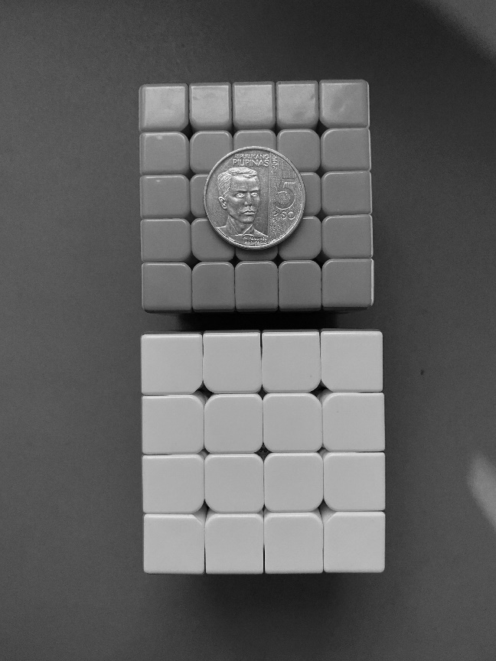
RESULTS & ANALYSIS
Converting to 8-bit
Applying threshold only works on grayscale images, so we convert it first.
Codes and files: https://github.com/genvert/AP_157_FX-2_Vertudez/tree/main/Activity%205

Slide 11
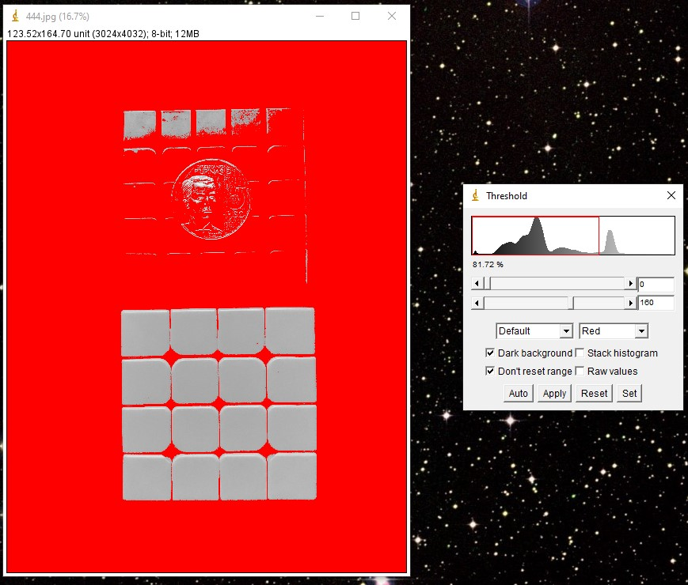
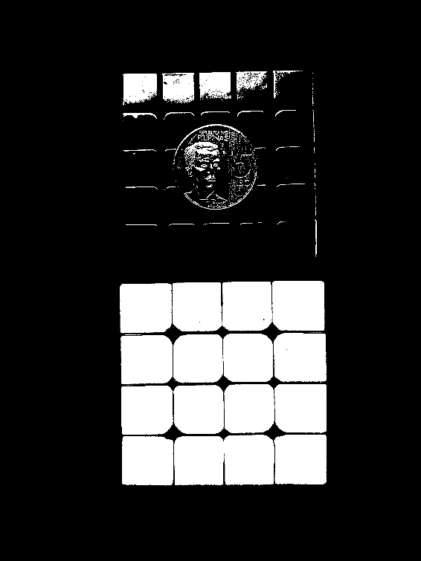
RESULTS & ANALYSIS
Applying threshold and binarizing
Since I want the 4x4x4 with white face, it is easy to pick it out from the background and other objects which are significantly darker.
The image is then binarized to make sure that there are only two values for easier extraction of geometric features.
Codes and files: https://github.com/genvert/AP_157_FX-2_Vertudez/tree/main/Activity%205

Slide 12
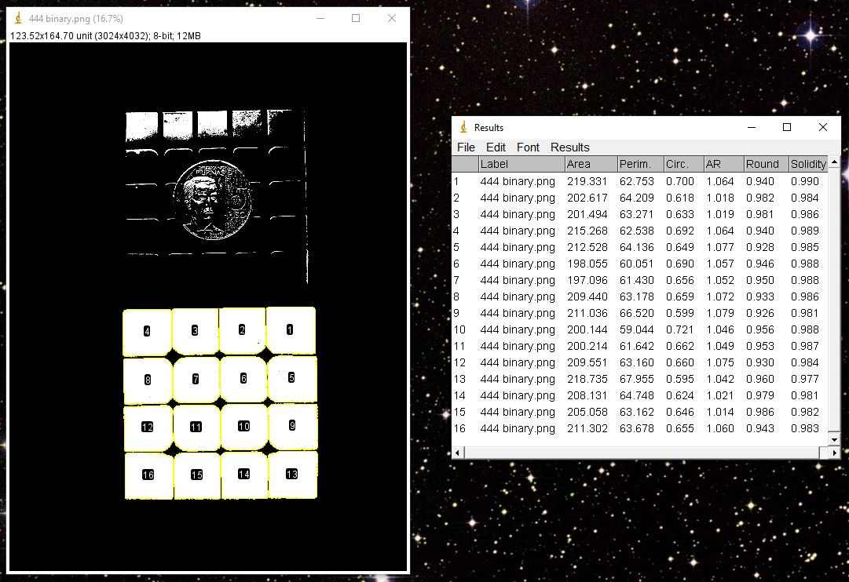
RESULTS & ANALYSIS
Analyze particles results
Codes and files: https://github.com/genvert/AP_157_FX-2_Vertudez/tree/main/Activity%205

Slide 13
RESULTS & ANALYSIS
Actually, I know that my 4x4x4 has a side of about 60 mm, which sets each ‘cubie’ as we call it, to have about 15 mm. This can be confirmed since the extracted area of each ‘cubie’ ranges from about 200-220 mm^2, whose square root is about 14-15 mm.
Moreover, we see that the perimeter of each ‘cubie’ is about 60 mm, which, when divided by 4 (approximating each ‘cubie’ as a square), is about 15 mm as well.
Amazing!
Codes and files: https://github.com/genvert/AP_157_FX-2_Vertudez/tree/main/Activity%205

Slide 14
REFLECTION
This activity was straightforward so I was able to follow it easily.
It is fun to recognize and understand the functions of different options in ImageJ based on our fundamental understandings of image processing. It is cool to know that you can do these manually with coding without the app.
I am grateful for this no-coding exercise. This is a breather exercise because I have been overwhelmed by coding lately.

Slide 15
SELF-GRADE
Technical correctness: 35/35
I am confident that I understood how to use ImageJ to extract feature from images, and have applied it.
Quality of presentation: 35/35
I have explained each step, and images are clear and concise.
Self-reflection: 30/30
Even though I was slacking in this subject for a while, I managed to get back on track. The topics are really fun and interesting. It helped me understand the ideas behind image tools such as smartphone cameras, Photoshop, etc.
Initiative: 10/10
I used an extra image for extraction.

